Slide 1
Parallel Computing
Lecture 1

Slide 2
Ubuntu Virtual Machine
Available right now at each one of our CS-Labs
You are strongly encouraged to install it on your laptop.
You can also create a Linux Partition (preferred)

Slide 3
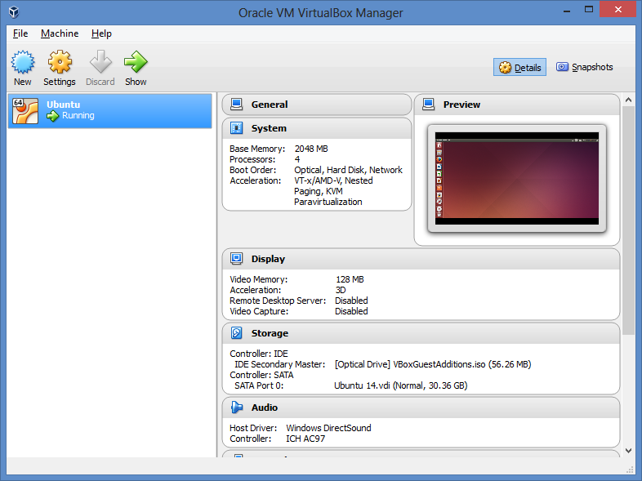
Ubuntu Virtual Machine

Slide 4
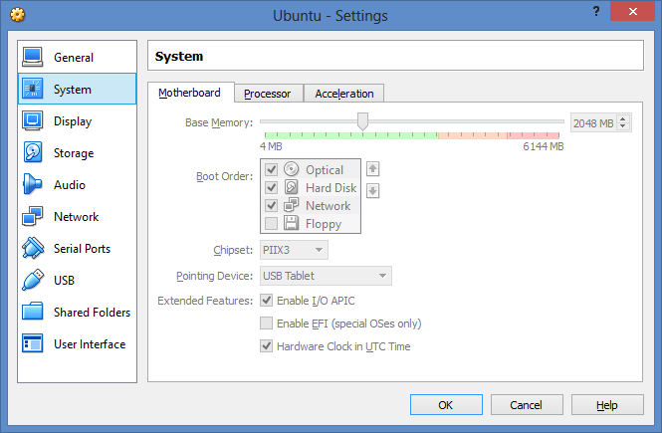
Ubuntu Virtual Machine
Settings

Slide 5
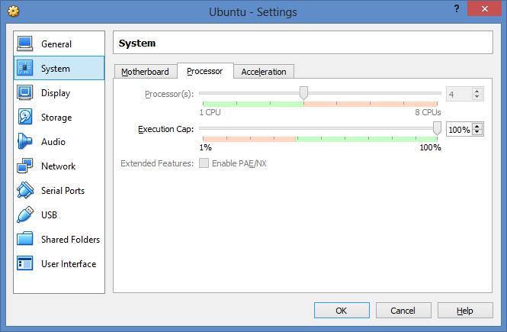
Ubuntu Virtual Machine
Processor

Slide 6
Ubuntu Virtual Machine
Useful Links
Ubuntu-Releases
http://releases.ubuntu.com/14.04/
How to install/configure an Ubuntu VM
https://www.youtube.com/watch?v=dhswfMpsb6c
How to install GCC (C compiler)
http://sysads.co.uk/2014/07/install-gcc-gnu-4-9-1-on-ubuntu-14-04/

Slide 7
How to install MPI in your VM
Message Passing Interface
The installation is very simple →:
eduardo@eduardo-laptop:~$ sudo apt-get install libcr-dev mpich2 mpich2-doc
If the command above fails, then you can consider such problem a non-graded mini-assignment. Solve the problem.

Slide 8
TACC
Stampede
https://www.youtube.com/watch?v=1W6MiM0rPk8
Stampede 2
https://www.tacc.utexas.edu/systems/stampede2
https://www.youtube.com/watch?v=fGAr_mfnwOk
Maverick
https://www.tacc.utexas.edu/systems/maverick

Slide 9
Software for this class
MPI
Pthreads
OpenMP
Windows users
WinSCP (https://winscp.net/eng/download.php)
Putty (http://www.chiark.greenend.org.uk/~sgtatham/putty/download.html)
Any other option of your choice
Mac and Ubuntu users:
Ssh

Slide 10
Parallel
Let’s talk about some general ideas
Divide and conquer
Embarrassingly parallel
Not always that easy
Data Dependent
Do more per unit of time
Get valid solution faster than regular sequential approach
Study BIG and complex problems

Slide 11
Do I want to use Parallel?
Answer YES.
Save time → Save $ (AMAZON, GOOGLE)
Solve Larger and computational challenging problems faster
Science and Engineering
Atmosphere, Earth, Environment
Physics - applied, nuclear, particle, condensed matter, high pressure, fusion, photonics
Bioscience, Biotechnology, Genetics
Chemistry, Molecular Sciences
Geology, Seismology
Mechanical Engineering - from prosthetics to spacecraft
Electrical Engineering, Circuit Design, Microelectronics
Computer Science, Mathematics
Defense, Weapons

Slide 12
Do I want to use Parallel?
Commercial and Industry
"Big Data", databases, data mining
Oil exploration
Web search engines, web based business services
Medical imaging and diagnosis
Pharmaceutical design
Financial and economic modeling
Management of national and multi-national corporations
Advanced graphics and virtual reality, particularly in the entertainment industry
Networked video and multi-media technologies
Collaborative work environments

Slide 13
Is this useful?
Let’s see
Obama, Trump
Jobs

Slide 14
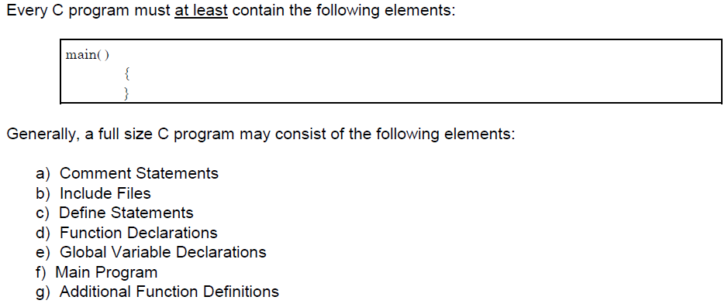
Introduction to C

Slide 15
Comments
Options:
/* this is the first this comment */
// this is the second comment
/*SJDSDSFSHJFSDHFGSDHFGSDHFGSDHFGSDFGSHDGFSHDGFSHDGFSHDFGSHDFGSHFGSDHFGSDHJFGSDHJFGSDHJFGSDJHFGSDHFGSDJHFGSDHFGSDHJFGSDHFGSDHFGSDHFGSDHFGSDHJFGSDHFGSDHJFGSDHJFGDSHFGSDHFGSDJF */

Slide 16
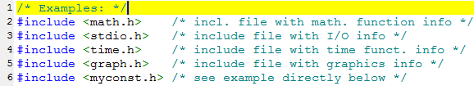
Header Files

Slide 17
Constants
a. #define PI = 3.1416
b. #define PI 3.1416;
c. #define PI 3.1416
d. #define float PI 3.1416

Slide 18
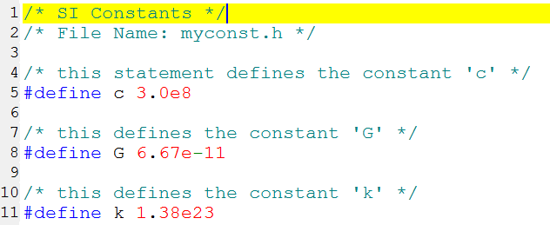
Constants
I want to include this fellow, what to do ?
Answer add as a header file, just like this
#include <myconst.h>

Slide 19
Common Mistakes with Constants
#define PI = 3.1416 /* W R O N G ! ! ! */
#define PI 3.1416; /* W R O N G ! ! ! */
#define PI 3.1416 /* R I G H T */
#define float PI 3.1416 /* W R O N G */

Slide 20
More Constants
Using #define preprocessor
Using const keyword.
Differences ?? YES →
Format: #define identifier value
Example: #define LENGTH 100
Format: const type variable = value;
Example: const int LENGTH = 100;

Slide 21
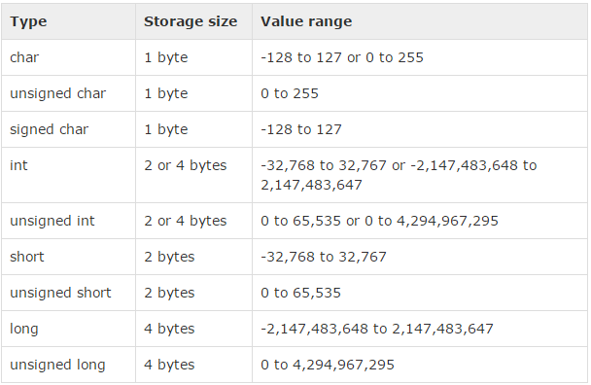
Integer Types

Slide 22
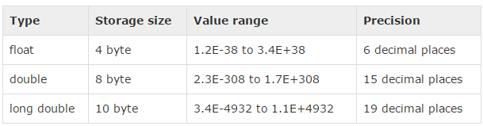
Floating Point Types

Slide 23
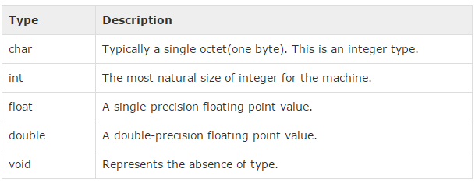
Data Type Summary

Slide 24
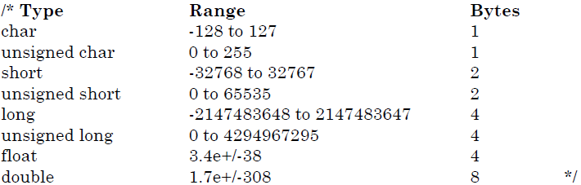
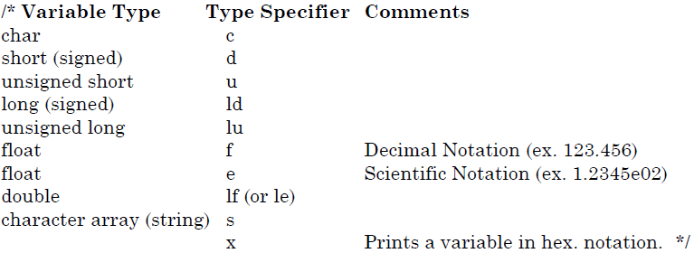
Data Types and Type Specifier

Slide 25
Global and Local Variables
Global
All variables created outside the main fx are GLOBAL VARIABLES
Lifetime: as long as the program runs they exist
Automatically Initialized to zero
Local
Variables created inside a function
Lifetime: as long as the FX is executed. Once the function concludes they are gone
NOT Automatically initialized to zero

Slide 26
Storage Classes
Auto
Register
Static
Extern

Slide 27
Storage Classes
Auto
The default storage class for all LOCAL variables
Can only be used WITHIN Functions
Example: auto int age;
Register
Defines LOCAL variables that will be stored in REGISTERS instead of regular RAM
The variable is subject to a size limitation, dictated by the size of the register
CANNOT use the “&” → WHY NOT ?
Because it does not have a memory location, it is a register remember
Example: register int speed;

Slide 28
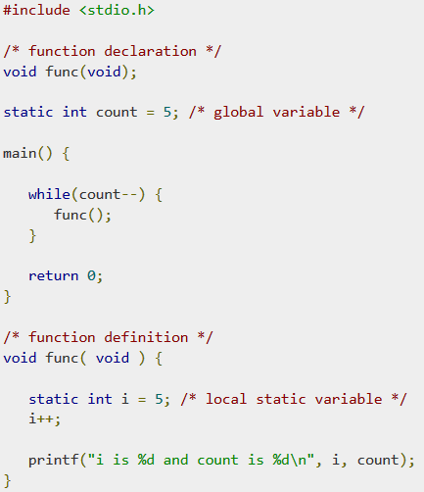
Storage Classes
static
Automatically initialized to zero upon memory allocation
Lifetime: As long as the program RUN they will exist
It will remember the last value that was given

Slide 29
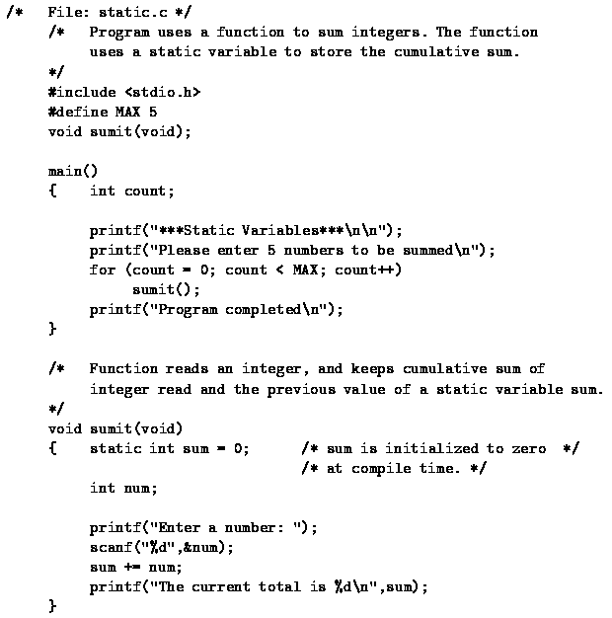

Slide 30
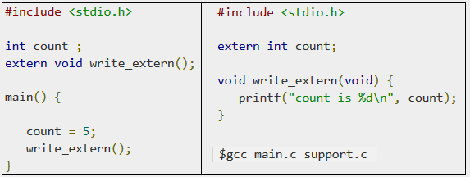
Storage Classes
extern
Used for GLOBAL VARIABLES (GV)
Will make GV visible to ALL program files
Used to declare a global variable or function in another file.
Most commonly used when there are two or more files sharing the same global variables or functions

Slide 31
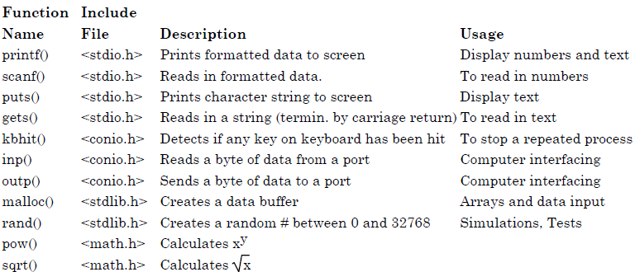
Predefined Functions

Slide 32
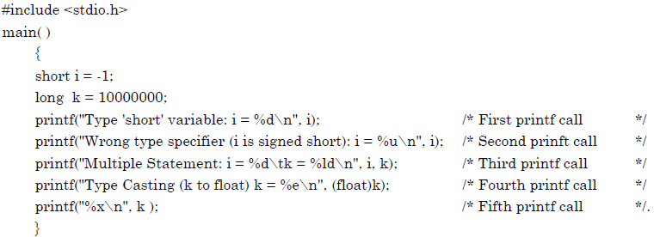
printf()
printf( "string %TypeSpecifier string", VariableName);

Slide 33
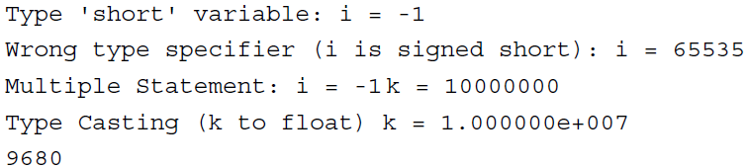
printf()

Slide 34
scanf()
Capture a number from keyboard
scanf( "%TypeSpecifier", &VariableName);
#include <stdio.h>
main()
{
int i; /* declare variable 'i' */
printf("Enter a number of type ‘int': ");
scanf("%d", & i);
printf("Value entered: %d\n", i );
}
MOST COMMON MISTAKE →
scanf("Enter a number: %d", &i);

Slide 35
getch()
It will capture a single numerical character from the keyboard
#include <conio.h> /* needed for getch */
#include <stdio.h>
main()
{
char ch; /* variable to store character returned by getch() */
printf("Enter a character: ");
ch = getch(); /* call getch function */
printf("\n The character entered was: %c", ch);
}

Slide 36
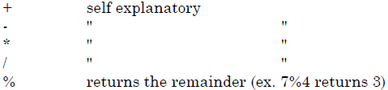
Arithmetic Operators

Slide 37
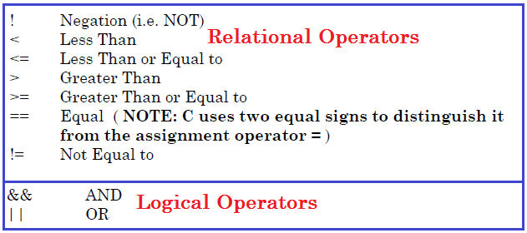
More Operators

Slide 38
Functions
#include <stdio.h>
/* Function Declaration */
float Fahrenheit( float Kelvin );
main( )
{
float a = 20; /* local variables */
float temp_F;
/* call function Fahrenheit */
temp_F = Fahrenheit(a);
printf("Temp is: %f\n",temp_F);
}
/* Function Definition */
float Fahrenheit( float Kelvin )
{
float temp;
temp = 1.8 *( Kelvin - 273) + 32.0; return( temp );
}
Have three important components
Function Declaration
Function Definition
Function Calls

Slide 39
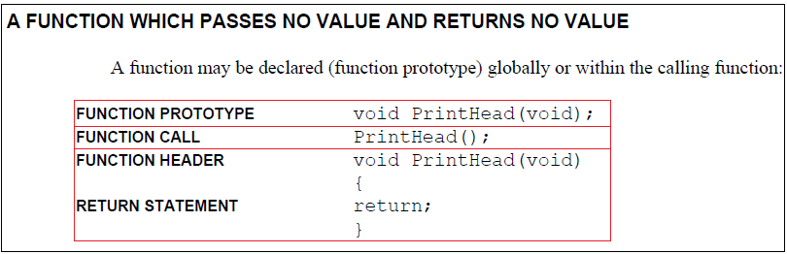

Slide 40
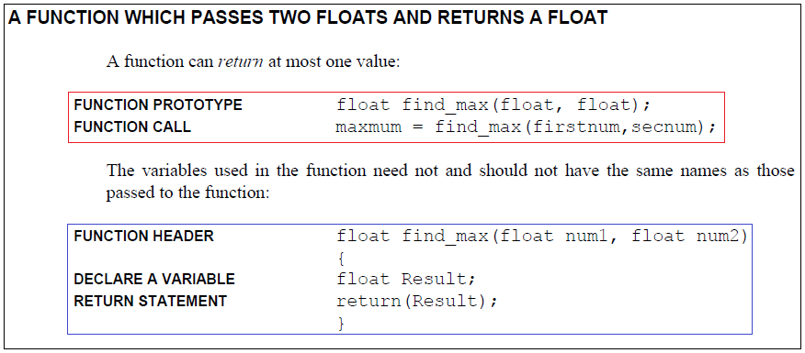

Slide 41
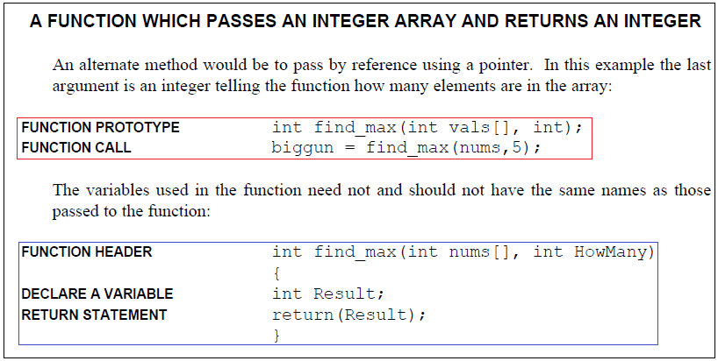

Slide 42
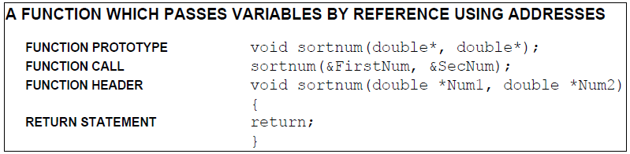

Slide 43
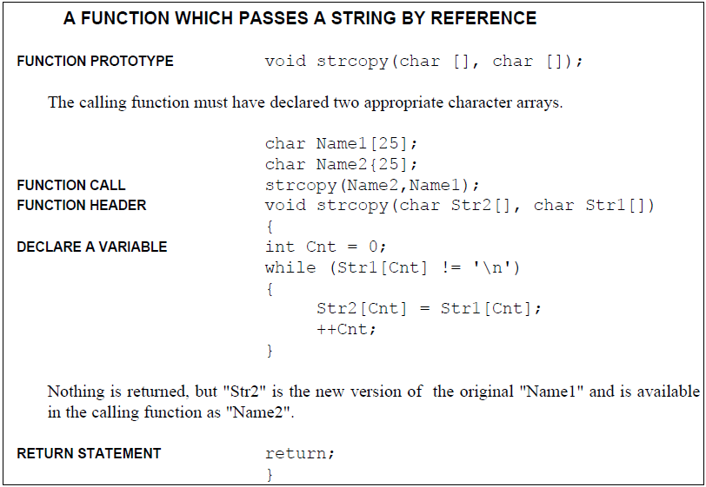

Slide 44
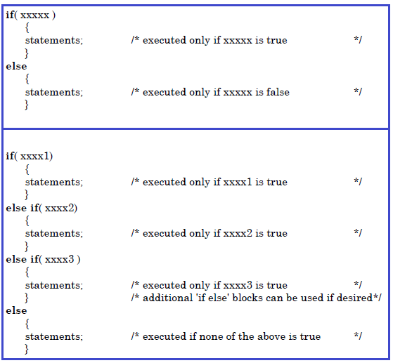
Branching Instructions

Slide 45

Branching Instructions

Slide 46
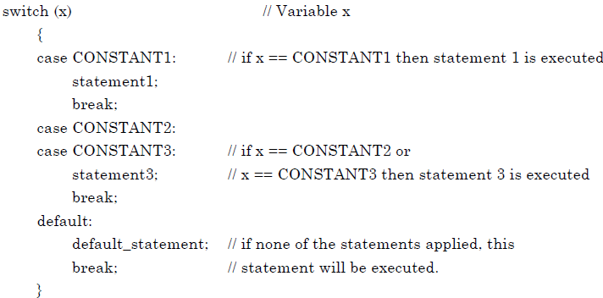
Branching Instructions

Slide 47
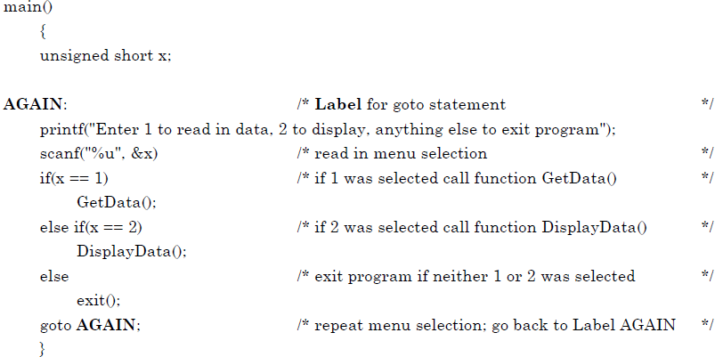
Branching Instructions

Slide 48
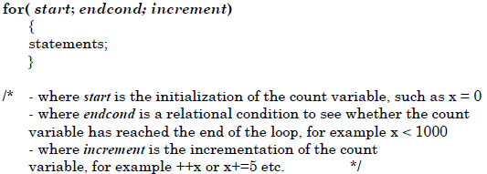
Loop Instructions
For Loop

Slide 49
Loop Instructions
#include <math.h>
#include <stdio.h>
double Factorial( double x );
double Poisson( double x, double mean);
main()
{
double x, mean;
printf("Enter Mean For Poisson Distribution: ");
scanf( "%lf", &mean );
printf("Enter x: ");
scanf( "%lf", &x );
printf("P(x): %lf \n", Poisson( x, mean ) );
}
double Poisson( double x, double mean)
{ /* P(x) = mx e-m x! */
return( pow( mean, x ) * exp(-mean) / Factorial(x) );
}
double Factorial( double n )
{
/* calculate n factorial (n! = 1*2*3*...(n-1)*n) */
double fact = 1;
double i;
for( i = 1; i <= n; i++)
{
fact *= i; /* short for: fact = fact * i */
}
return( fact ):
}
For Loop
Example

Slide 50
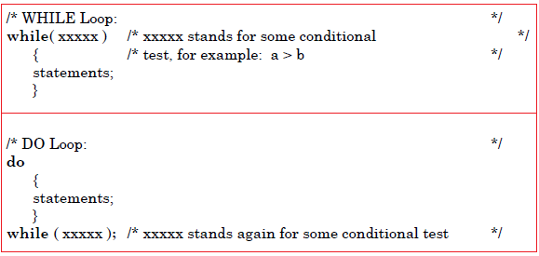
Loop Instructions
While and Do Loops

Slide 51
Loop Instructions
Nested Loops
One of the possible ways to sweep a matrix
Column Wise, or Row Wise
main()
{
short row, column;
for( row = 1; row < 5; ++row)
{
for( column = 1; column < 4; ++column)
{
printf("row: %d column: %d\n",row,
column);
}
}
printf("That's it folks!");
}

